Slide 1
Project Review
Purpose:
Review current state of software/system infrastructure
Present vision for future infrastructure
Suggest a migration plan

Slide 2
Introductions
Martin Bruun, Primary Customer
  Originator/Owner, On Call Estimation
  Over 40 years experience in construction industry and materials estimation
Rita Akhtar
  Business side of the operations
  Has been providing main source for funding
  Rita is head of the Fulbright Foundation in Pakistan
  Currently setting up team of estimators in Pakistan who will be assisting Martin
Gordon Rosen
  Extensive business experience, including experience in the construction industry
  Wants to use system for a SAS product
Prof. Orlando Karam, Consultant
  Worked with Orlando at Microsoft
  Taught computer science at the University level
  Extensive knowledge and experience of all things computer science and implementation
  Currently working for a Microsoft spin off in Atlanta
  Has agreed to look at our issues.
Bernie Schoch, Part time programmer, Consultant
  Works for Verisign
  Has been providing part time support on an ‘as available’ basis

Slide 3
Introductions
Alex Payne, Part time programmer, Consultant
  Has been providing part time support on an ‘as available’ basis
Marc Diamond, Primary programmer
  Long professional history, mainly in the areas of mathematics and operations research
  Primary programmer on the ‘phase 1’ version of the product.

Slide 4
Current Status -- Business
Martin and Rita have started a small mom-and-pop type company directed to providing support to architects in estimating costs
The current focus is specifically floor and baseboard materials, but plan is to extend into other areas in the future.
The business model is superb. Martin started soliciting customers and has received bids from just about everyone he has contacted. There is a lot of demand for this type of service.
Plan is to set up a team of estimators in Pakistan to help manage business volume
Currently working contracts based on the ‘phase 1’ version of the code.
They have a web site set up to support their business
Gordon Rosen has plans to extend the business and provide a self-serve ‘software as a service’ function

Slide 5
Current Status -- Software
Considered ‘phase 1’
Extensive:
  ¼ million lines of code
  Complex interaction of GUI components
  Complex numerical and geometric (mainly polygon) operations
  Some optimization functionality baked in
Technologies
  VS 2019, .Net 4.5, C#
  External open source libraries for geometric and other operations
  Winforms
  Visio add in for drawing. Note: Visio geometry engine is used extensively.

Slide 6
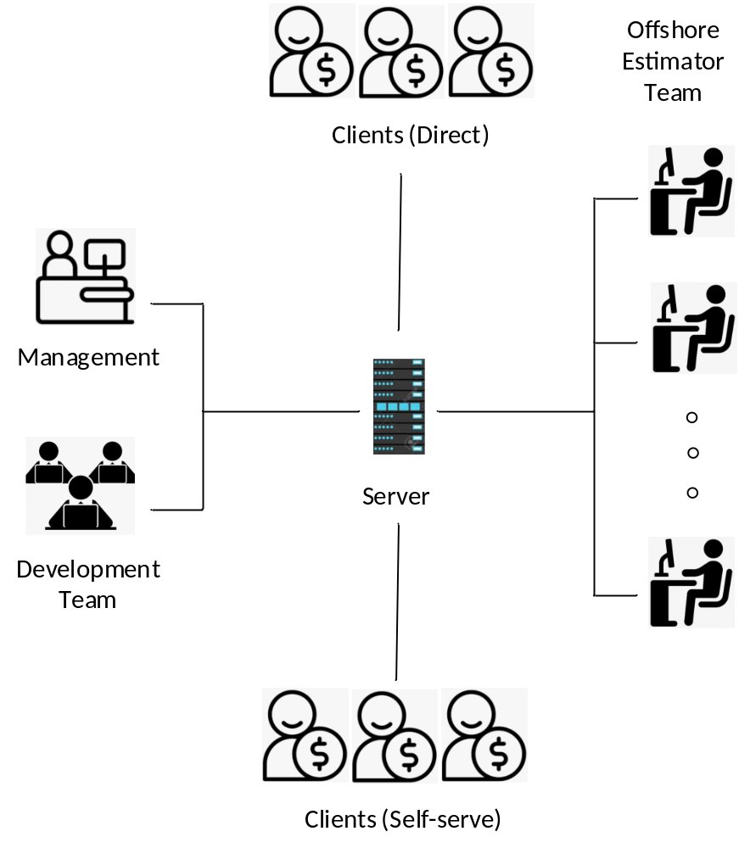
Phase 2 Vision
Martin has a long wish-list of upgrades to Phase 1 product. I have some ideas also.
Martin/Rita wish to keep venture as a limited, mom-and-pop operation. Gordon wants to extend to full blown business
Beyond just floor materials. Gordon wants to extend to electrical, plumbing, framing etc.

Slide 7
Technical Challenges
Want to migrate to .Net core.
  Means we will need wrappers for com add ins
Replace winforms with wpf (not a big issue)
Main challenges:
  Desktop vs. Web
  If Web
    Server vs. client break out of code
    Technologies to support interactive GUI
      Blazer
      WebGL
      Others?
  If Desktop
    Replacement for Visio?
    OpenGL, DirectX, Synfusion Diagram platform, Others?
    Support for Layers is critical!!!

Slide 8
Notes:
Phase 1 code is not all that well organized, due to design on the fly, but I am currently refactoring and reorganizing code
Would prefer a migration path to a complete rewrite – I believe a lot of the origin code can be salvaged
Now that I understand the problem, I will produce a design document for phase 2.
In design of phase 1, much of the graphics support for Visio has been isolated into a few methods, meaning transition to other platforms and technologies should be relatively painless

Slide 9
Your challenge, Prof Karam…
…should you choose to accept it (to the theme of mission impossible)
Work with Bernie and Alex to decide on the best technologies to support Phase 2.

